Slide 1



The History of AI (The pictures are clickable!)
Written by: Gemini
Made by: Milan Pelyvas

Slide 2
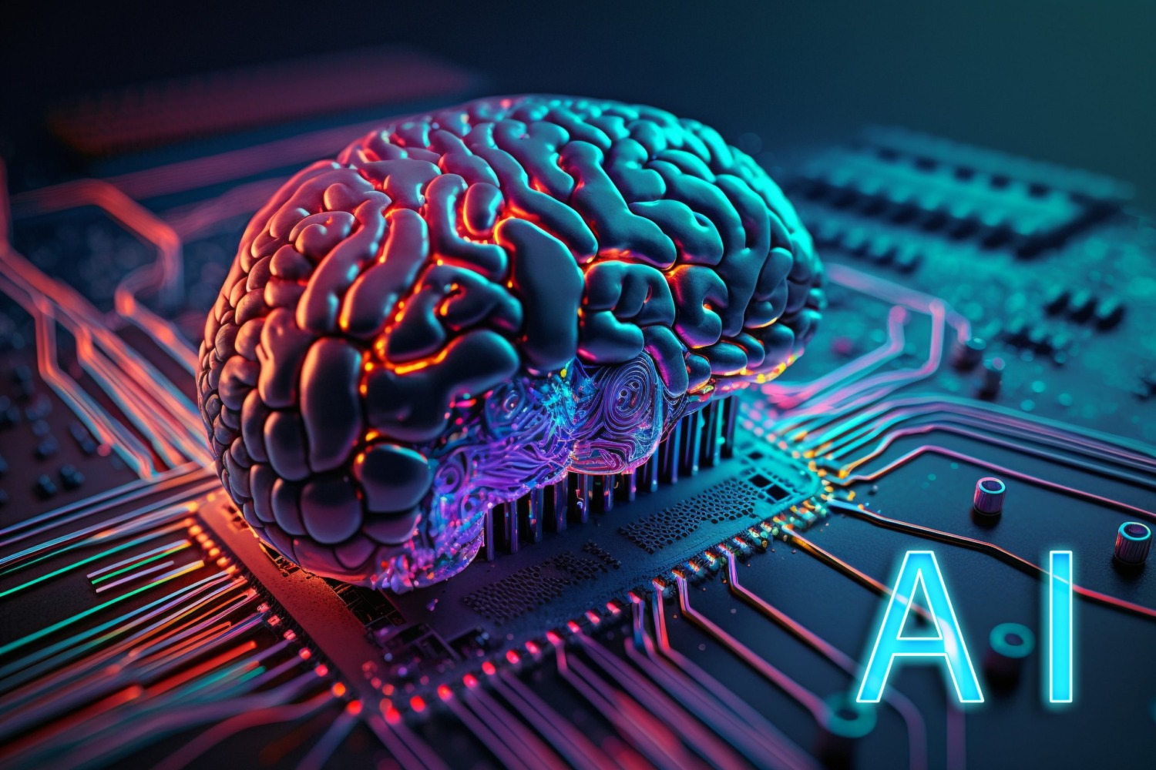
Introduction
What is AI?
Artificial intelligence (AI) is technology that enables computers and machines to simulate human learning, comprehension, problem solving, decision making, creativity and autonomy.
Applications and devices equipped with AI can see and identify objects. They can understand and respond to human language. They can learn from new information and experience.

Slide 3
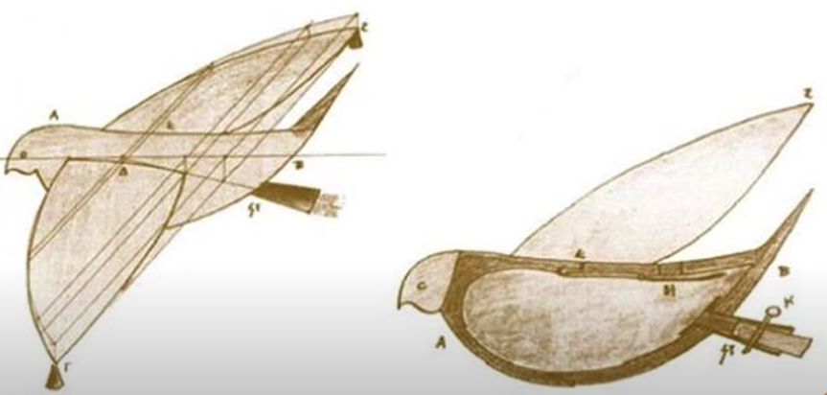
Ancient Roots
The idea of “artificial intelligence” goes back thousands of years, to ancient philosophers considering questions of life and death. In ancient times, inventors made things called “automatons” which were mechanical and moved independently of human intervention.
The word “automaton” comes from ancient Greek, and means “acting of one’s own will.” One of the earliest records of an automaton comes from 400 BCE and refers to a mechanical pigeon created by a friend of the philosopher Plato.
Many years later, one of the most famous automatons was created by Leonardo da Vinci around the year 1495.

Slide 4
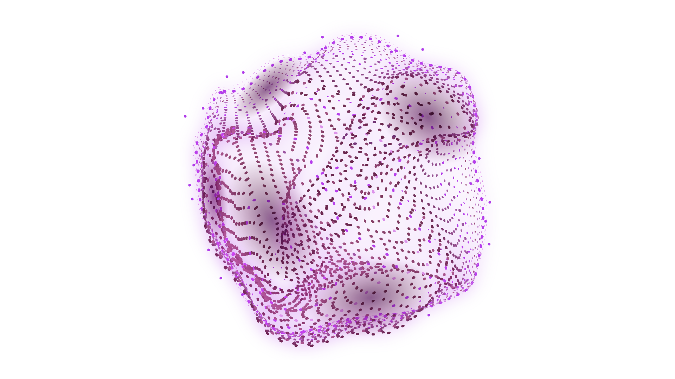

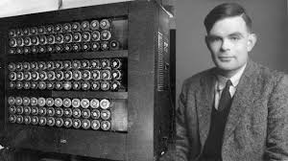
The Birth of Computing
The first computer was invented by Charles Babbage (1822) but was not built until 1991!
Alan Turing invented computer science. The ENIAC (1945) was the first electronic general-purpose digital computer; it filled a room.
The Micral N was the world’s first “personal computer”(1973). It was not a commercial success.
The Epson HX-20 (1981) was the world’s first laptop, although you wouldn’t recognize it as a laptop today. The first Mac debuted in 1984.

Slide 5
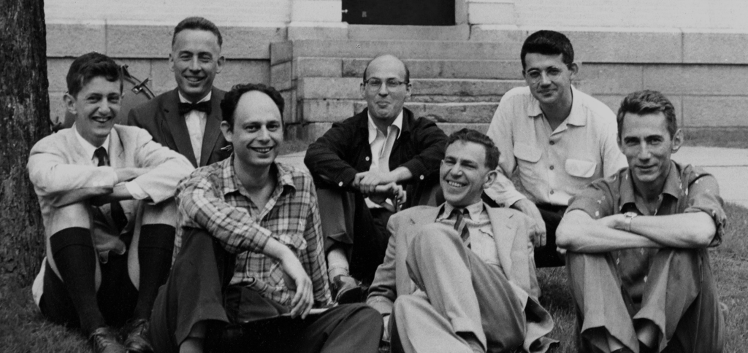
The Dartmouth Conference
In 1955, John McCarthy, then a young Assistant Professor of Mathematics at Dartmouth College, decided to organize a group to clarify and develop ideas about thinking machines. He picked the name 'Artificial Intelligence' for the new field. He chose the name partly for its neutrality; avoiding a focus on narrow automata theory, and avoiding cybernetics which was heavily focused on analog feedback, as well as him potentially having to accept the assertive Norbert Wiener as guru or having to argue with him.
In early 1955, McCarthy approached the Rockefeller Foundation to request funding for a summer seminar at Dartmouth for about 10 participants. In June, he and Claude Shannon, a founder of information theory then at Bell Labs, met with Robert Morison, Director of Biological and Medical Research to discuss the idea and possible funding, though Morison was unsure whether money would be made available for such a visionary project.

Slide 6
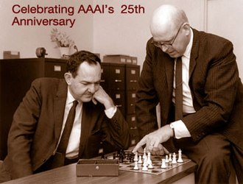

Early AI Research
In 1955, Allen Newell and future Nobel Laureate Herbert A. Simon created the "Logic Theorist", with help from J. C. Shaw. The program would eventually prove 38 of the first 52 theorems in Russell and Whitehead's Principia Mathematica, and find new and more elegant proofs for some.^{[75]} Simon said that they had "solved the venerable mind/body problem, explaining how a system composed of matter can have the properties of mind."^{[76][c]} The symbolic reasoning paradigm they introduced would dominate AI research and funding until the middle 90s, as well as inspire the cognitive revolution.

Slide 7
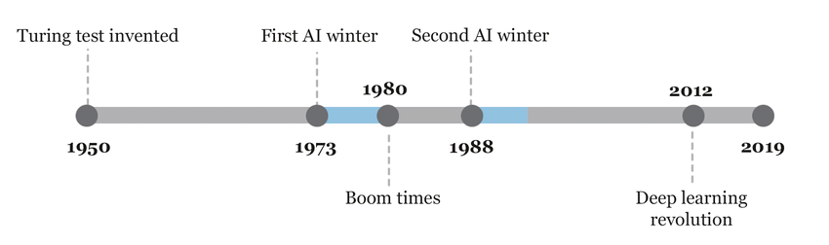
AI Winter
In the 1970s, AI was subject to critiques and financial setbacks. AI researchers had failed to appreciate the difficulty of the problems they faced. Their tremendous optimism had raised public expectations impossibly high, and when the promised results failed to materialize, funding targeted at AI was severely reduced. The lack of success indicated the techniques being used by AI researchers at the time were insufficient to achieve their goals.

Slide 8
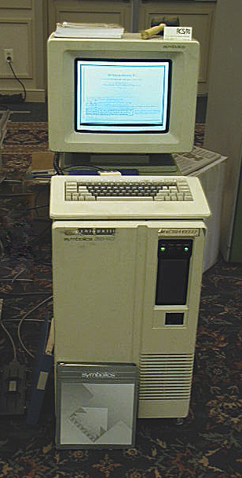
The AI Renaissance
An expert system is a program that answers questions or solves problems about a specific domain of knowledge, using logical rules that are derived from the knowledge of experts. The earliest examples were developed by Edward Feigenbaum and his students. Dendral, begun in 1965, identified compounds from spectrometer readings. MYCIN, developed in 1972, diagnosed infectious blood diseases. They demonstrated the feasibility of the approach.

Slide 9
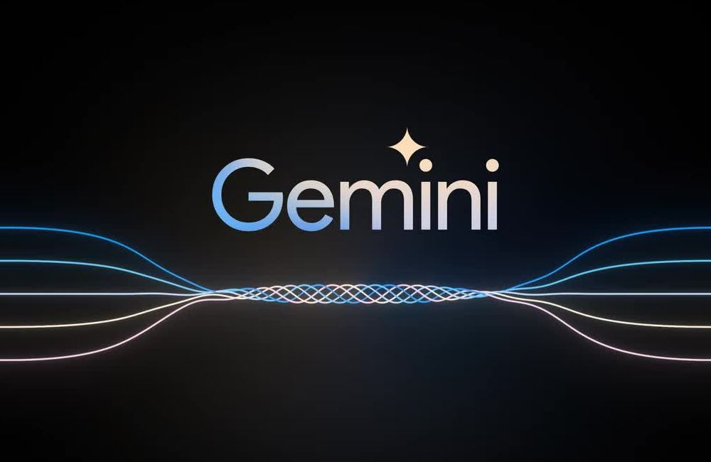
AI in the Modern Era
Large language models, based on the transformer, were developed by AGI companies: OpenAI released GPT-3 in 2020, and DeepMind released Gato in 2022. These are foundation models: they are trained on vast quantities of unlabeled data and can be adapted to a wide range of downstream tasks
<- Shoutout to this guy for helping me

Slide 10
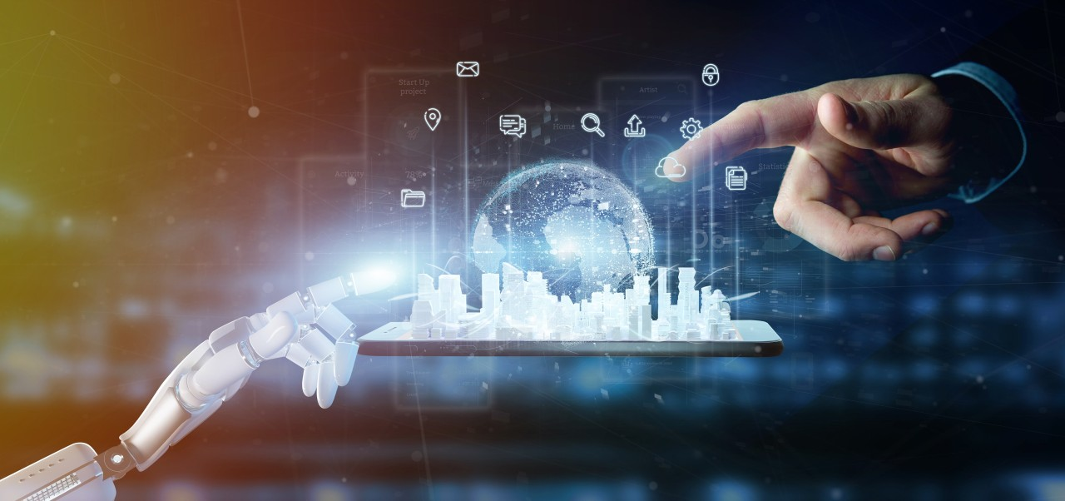
AI and Society
The future of AI is bright and full of possibilities. As society continues to embrace this technology, it is crucial that we remain mindful of its impact and work to address the challenges that come with its evolution. By doing so, we can ensure that AI continues to play a positive role in our world, improving our lives and creating a better future for generations to come.

Slide 11
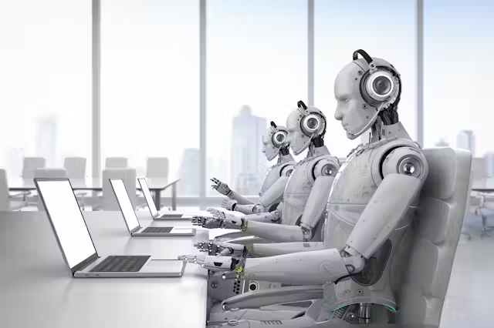
AI and the Future of Work
The future of work in the age of AI is rich with opportunities and challenges. Businesses and professionals can confidently navigate this transformative era by debunking myths and embracing a proactive approach. AI is not a threat but a tool that, when used ethically and strategically, can unlock new potential and drive unprecedented growth. As we move forward, our success lies in our ability to adapt, learn and innovate in harmony with AI.

Slide 12
Conclusion
From the mechanical pigeon designed in 400 BCE, Alan Turing inventing ENIAC to the release of ChatGPT, AI truly came a long way. Instead of fearing what the future may hold, we should embrace our current technology, and strive to improve it.

